Slide 1

Character Recognition

Slide 2
Introduction
Character recognition is a field that deals with the recognition of characters embedded in pictures that may be acquired in numerous ways, depending upon the system under study.
Optical character recognition (OCR) applies to the printed documents that have optical characters placed on them. A related field is handwriting recognition, where we try to extract text scribbled by a person.
The problem of character recognition has been applied to various systems. Extracting text from images, converting scanned documents to text, product identification, and vehicle identification are few of the systems that are extensively used in daily life.
OCR refers to the problem of identifying the character that is written or drawn. The recognition gives us in text form the character that is likely to be present in the given picture.

Slide 3
Introduction
Character recognition is usually studied under two separate heads :
Offline Character Recognition
Online Character Recognition
The offline technique has the final character or picture given directly.
In online technique the character is written in the presence of the system. Hence we may sample the character at various times to learn about its formation.
Multilingual Character Identification
This technique uses a mixture of a rule-based approach along with the ANN to identify characters. Every language has its own ANN. Once the language is known, we use the language-specific ANN to identify the exact character.

Slide 4
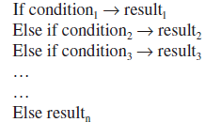
Introduction
We study the problem of handwriting recognition and develop a genetic algorithm solution to the problem.
There are numerous styles that may be used to write the various alphabets. These styles change as the person grows and gets exposure to newer styles.
We use the genetic algorithms for the problem of handwriting recognition. We try to use genetic operators to evolve hybrid styles that may more closely match the given character. At any time, we try to mix existing styles to make newer styles of the character we are trying to match the given character with.
In a rule-based approach, we keep firing the rules, one after the other..

Slide 5
Introduction
ANN is used here for its power to learn historical data and to generalize and store those data.
We map the inputs to the outputs using a network of processing units called neurons. The neurons are connected to each other by weights that can vary. The output that any input would produce is decided on the basis of these weights between any two neurons.
We have made different ANNs for the various languages. These ANNs are trained from the training data in the respective languages.

Slide 6
General Algorithm Architecture for character Recognition
The general steps involved in the algorithm are as follows:
Image acquisition : shoot the image
Binarization : Convert the image to a binary format where each pixel is either black or white.
Layout analysis : Need to explicitly cite the text and understand the way it is oriented in the entire document.
Preprocessing : Processing of the input character and converting it into a form that can be used as an input to the recognition system.
Segmentation : The entire input is broken down to a character.
Character recognition : The algorithm classifies the character and so recognizes it.

Slide 7
General Algorithm Architecture for character Recognition
Binarization
It is the converting of image into a binary format of black and white. The basic objective is to set a threshold. All pixels above this threshold will be marked as white, and all pixels below this threshold will be marked as black.
Two techniques used are :
Global feature thresholding.
local feature thresholding.
Preprocessing
It includes various preprocessing techniques that must be performed on the image in order to effectively extract and recognize the text.
procedure involves image noise removal, correction, regularization, etc.

Slide 8
General Algorithm Architecture for character Recognition
Filters
One commonly used method of noise removal is the application of noise filters.
It is assumed that the noise is linearly added to the image to give the corrupt image. The use of low-pass filters is very common to correct the variations in the higher frequencies where the noise is present.
Smoothing
Smoothening causes an effect of blurring, which further helps in the reduction of the noise effects. Blurring causes the removal of small parts that may have been left over in the image.
In filtering, we use a mask around a pixel to fix the values of the pixel, depending upon the values of the pixels around.
The mask is rotated in the entire image to correct the image.
The filtering may be linear or nonlinear.

Slide 9
General Algorithm Architecture for character Recognition
Skew Detection and Correction
Skew is the rotation that may have occurred in the image due to improper placing of paper while scanning or improper shooting of the image or any other reason.
The undue rotation may cause an adverse effect in the performance of the system. The skew hence needs to be detected and corrected.
Slant Correction
Many times the character may be inclined at a certain angle over the text in the document. This is what happens in case of cursive handwriting, where the curves are not normal to the baseline. There is a certain slant. This slant further induces an ill effect in the recognition of the characters in text.

Slide 10
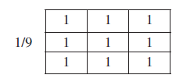
General Algorithm Architecture for character Recognition
Character Normalization
In this step, the image is normalized and is made to lie in some standard coordinates with some standard size. This fixes the area covered by the character.
The normalization may be done by linear mechanisms, moment-based mechanisms, or nonlinear mechanisms.
The 3 × 3 averaging filter mask.

Slide 11



General Algorithm Architecture for character Recognition
The averaging filter mask.
The filter for binary images.
The filter for binary images

Slide 12


General Algorithm Architecture for character Recognition
The filter for binary images
The filter for binary images..

Slide 13
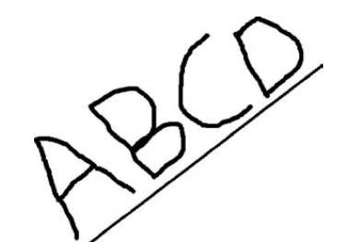
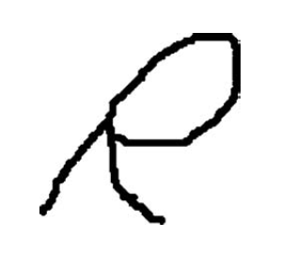
General Algorithm Architecture for character Recognition
The skew effect
The slant.

Slide 14
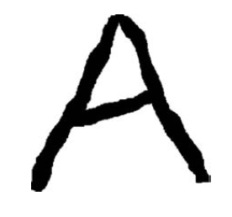
General Algorithm Architecture for character Recognition
The original characters.

Slide 15
General Algorithm Architecture for character Recognition
Thinning
Thinning is the process by which the character’s lines are narrowed to an extent that all strokes in it are of a unit thickness.
Two commonly used thinning algorithms are :
Hilditch’s Thinning Algorithm.
Zhang-Suen’s Thinning Algorithm.
Segmentation
Segmentation is normally done using edge detection mechanisms
Here we try to detect edges present in the entire image. The edges are the boundaries of the objects that separate the object from the rest of the surroundings.
The operator used is called as the Laplacian of Gaussian, or LoG, operator. The KCS filter is another commonly used technique for this purpose.

Slide 16
Multilingual OCR By Rule-Based Approach And ANN
We solve the problem of OCR using a hierarchical approach involving a rule-based approach and ANNs.
The identified language has an ANN of its own. This ANN was trained using the characters of this language exclusively. We select this ANN and give the character as an input to it. The output returned by this ANN is the final identified output.
We have used English capital letters, English small letters, and Hindi letters for this algorithm. The general structure of the algorithm is given in the figure. In this algorithm, the input is a matrix of 14 × 14. Each of these represents a pixel.
The pixel is marked as 1 or –1, depending on whether something was written in the area of that pixel or not. If something was written, the pixel is marked as –1; else, the pixel is marked as 1.

Slide 17
Multilingual OCR By Rule-Based Approach And ANN
If the given input is found to be an English capital letter, the original input matrix is scaled down to a scale of 7 × 7. This may be done by deleting alternative rows and columns.
If the given input is of Hindi characters, we do not scale down the original image. Rather we break it into sections. These sections are made in accordance with the philosophy of the Hindi characters.

Slide 18
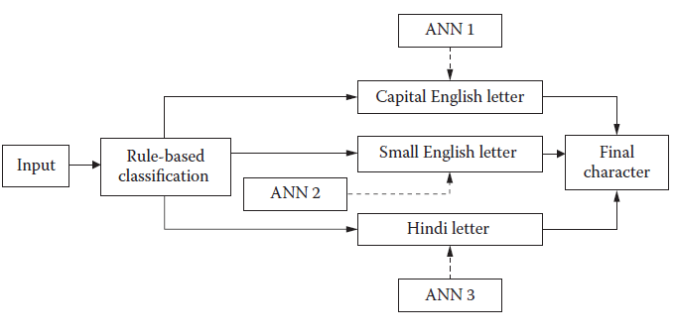
Multilingual OCR By Rule-Based Approach And ANN
The general recognition algorithm.

Slide 19
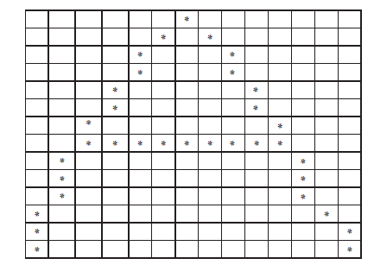
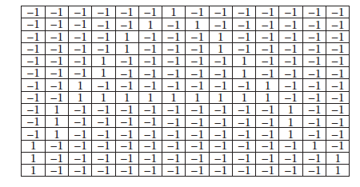
Multilingual OCR By Rule-Based Approach And ANN
The logical algorithm input.
The converted algorithm
input.

Slide 20
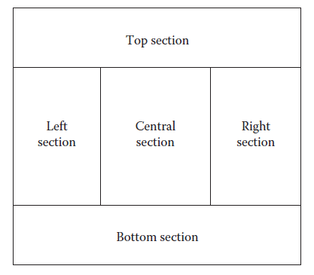
Multilingual OCR By Rule-Based Approach And ANN
Segmentation of the Hindi characters.

Slide 21
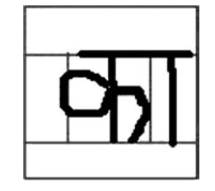
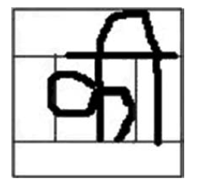
Multilingual OCR By Rule-Based Approach And ANN
Use of various segments.
Use of various segments.

Slide 22
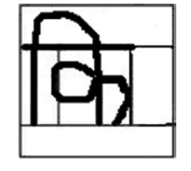
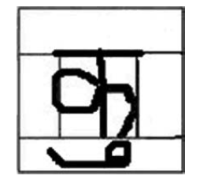
Multilingual OCR By Rule-Based Approach And ANN
Use of various segments.
Use of various segments.

Slide 23
Rule - Based Approach
This is the first step.
The algorithm tries to find out the class to which the input belongs.
In this problem for identification of English/Hindi characters, we have taken three classes :
The first class corresponds to the capital English characters (A–Z).
The second class corresponds to the small English characters (a–z).
The third class corresponds to the Hindi characters.
Classification
These 3 classes are furthermore divided into more classes.

Slide 24
Rule - Based Approach
Various classes of A(Capital) :
Class A-1: A, B, D, E, F, I, J, K, M, N, P, R, T, Y
Class A-2: C, O, S, U, V, W, X, Z
Class A-3: E, F, I, T, Z
Class A-4: H, L
Class A-5: G, Q
Class A-6: J
Classes for small English letters :
Class B-1: b, d, h, i, j, k, l, p, t
Class B-2: a, e, f, g, m, n, q, r, x, y
Class B-3: c, o, s, u, v, w, x, z

Slide 25
Rule - Based Approach
For the Hindi characters, we have just one class. This class comprises all the characters found in Hindi and also incorporates all the combinations allowed by the language.
Common characteristics between the different subclasses :
All the characters of class C have a line at the top.
Classes A-3 and A-6 are the only characters of the Class A that have a horizontal line at the top.
More specifically, A-3 is the class all of whose members have a horizontal line at the top and the consist of a set of lines only with no curve.
Class A-2 and B-3 are the similar classes. Here the character is written in the same way in English capital and English small letters.
Class B-1 is the set of characters in small English characters, where there is a small vertical line at the top.

Slide 26
Rule - Based Approach
Class A-4 is the only set of characters in English capital characters that have a vertical line at the top.
Class A-1 is the set of characters in capital English characters where there is always a straight line that joins the topmost and leftmost point to any other point.
Class A-5 is the class that does not contain a line from the topmost and leftmost point.
Tests
The tests will enable us to check for the presence of various characters and subclasses.
The first major concept is traversal. Here we travel the points where ink is present. The traversal starts from a predefined location on the given input.
If we are on a line or curve, we get only one option to proceed with our traversal.

Slide 27
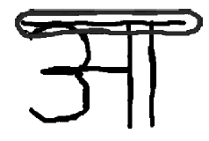
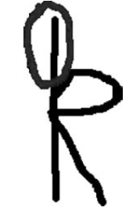
Rule - Based Approach
Top line half.
The top line in B-1.

Slide 28
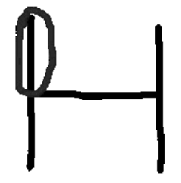
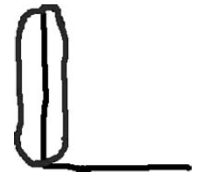
Rule - Based Approach
The vertical line at Class A-4.

Slide 29
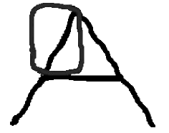
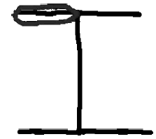
Rule - Based Approach
The straight line in A-1.

Slide 30
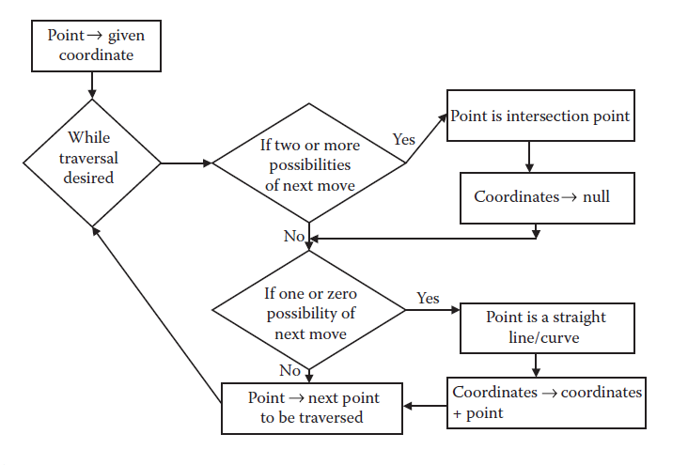
Rule - Based Approach
The traversal algorithm.

Slide 31
Rule - Based Approach
Class C Test
In this test, we check for the top vertical line in the character. The general way is to do this test is to find out the rightmost point in the top 1/3 of the input grid. This can be taken as the rightmost point in the horizontal line that we wish to find.
Class A-3 Test
In this test we check whether the figure contains only lines, or it contains both lines and curves. We start from the topmost and leftmost point. Using this point, we start traversing. At every intersection, we traverse all the points possible.
At the end of this procedure, we clearly know all the sets of paths that may be lines or curves.

Slide 32
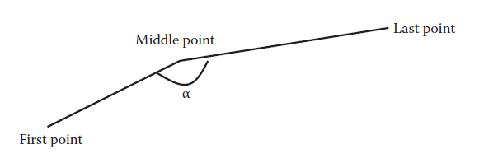
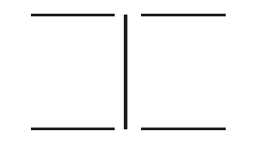
Rule - Based Approach
The angle for line detection.
The five different paths for letter I.

Slide 33
Rule - Based Approach
Class A-6 Test
The purpose for this test is to test whether the given input is J. This test checks for the presence of one top line and one curve at the bottom.
Class B-1 Test
This test checks for the presence of a small vertical line of at least 1/3 the length of the whole character at the top of the character. We find out the topmost and the leftmost point in the given input. We start traversing from this point.
Class A-4 Test
The purpose of this test is to check for the availability of H and L. These are the two characters with a vertical line and without curves. The test is similar to the B-1 test. Here we also apply a test similar to A-3 test to find five straight lines for H and two straight lines, one vertical and one horizontal (or one curve) for L.

Slide 34
Rule - Based Approach
Class A-1 Test
In this test, we check for the presence of a straight line traversing from the top-left point. This test is similar in nature to the Class C test.
Class A-5 Test
In this test we check for the presence of G and Q. These are predominantly curves in nature. If we traverse leftward from the top-left position, we will find a curve in both of these figures.
Rules
To distinguish between members of class A and class B, class B and class C, and class A and class C.

Slide 35
Rule - Based Approach
If Class C test is positive and Class A-3 test fails → Class C
Else if Class C test is positive and Class A-3 test is positive → Class A
Else if Class C test is positive and Class A-6 test is positive → Class A
Else if B-1 test is positive and A-4 test is negative → Class B
Else if B-1 test is positive and A-4 test is positive → Class A
Else if A-1 test is positive → Class A
Else if A-5 test is positive → Class A
Else Class B

Slide 36
Artificial Neural Network
The database of every ANN consists only of the limited number of characters that belong to the same class or language. As a result, the problem is much simpler and becomes easy to solve with the help of the ANN.
In this problem, the ANNs of the English capital and English small letters are identical. The ANN of Hindi characters differs in some amount, where different ANNs were applied to different segments of the image.
The segments into which we broke a Hindi character were top segment, bottom segment, center segment, left segment, and right segment.

Slide 37
Artificial Neural Network
Inputs
The input of any neural network is a grid. The grid is a collection of 1 and –1. The 1s denote that there was something written in that position. On the other hand the –1s denote the absence of anything written in that position.
Outputs
Both capital and small English has 26 such output classes. The number of outputs in our neural network is actually the number of such output classes. For any input i, there are the same number of outputs as there are classifying classes.
This value may lie between –1 and 1. 1 is the highest probable, and –1 the least.
We have the neural network of the capital English characters. It takes a grid of 7 × 7 as input. Hence there are 49 inputs, <I1, I2, I3, I4….. I49>.

Slide 38
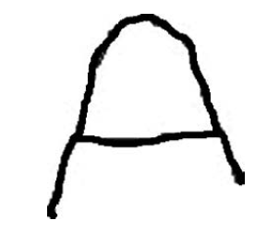
Artificial Neural Network
The output array would be in form <O1, O2, O3, O4….. O26>. Here O1 corresponds to A, O2 to B, O3 to C, and so on.
If we are giving the training data for B, we know that the possibility of O2 will be 1 and the possibility of any other output will be –1. Hence the training data output for B will be <–1, 1, –1, –1…–1>. While testing we find the highest output, max(Oi), for all I from 1 to 26.
Various styles of writing A. Au: Please

Slide 39
Artificial Neural Network
Identification
In capital English characters and small English characters, we straightaway get the final answer.
But in Hindi character recognition, we get the presence of various signs at the top, bottom, right, left, and center positions.
Once it is known what lays at all the positions, we may easily come to know the final character (character and the vowel associated).

Slide 40
Results Of Multilingual OCR
The discussed system was implemented in MATLAB. The specific code that deals with graphs was implemented in Java. The training data sets were made to train the individual ANNs of the system. Then we made the main logic that differentiated languages.
We set up a total of 218 test cases, out of which the system could correctly identify 193 test cases. This returned an efficiency of 88.53 percent in the presence of numerous characters and languages.

Slide 41
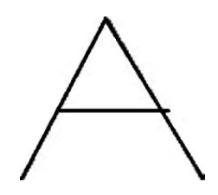
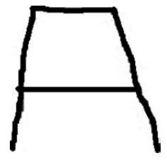
Algorithm for Handwriting Recognition using GA
Every soft computing system requires a good and diverse training database that must cover all diversities that may be present in the data for best performance.
There are numerous styles in which a character may potentially be written. All these vary from person to person.
Various styles of writing A.

Slide 42
Algorithm for Handwriting Recognition using GA
Here we use GA to solve the problem of handwriting recognition.
The unknown input is matched to the characters present in the database , and the best match is found. In this way, the GA is used to optimize the match between the unknown character and the hybrid characters generated from the characters available in the training data set.

Slide 43
Algorithm for Handwriting Recognition using GA
HandwritingRecognition(Language,TrainingData,InputImage)
Step 1: For every character c in language
Do
Step 2: For every input i for the character c in test data
Do
Step 3: Generate graph gci of i
Step 4: Generate graph t of input image
Step 5: For every character c in language
Do
Step 6: Use the genetic algorithm to generate hybrid graphs
Step 7: Return the character corresponding to the graph with the minimum most fitness function
(out of the graphs generated in any genetic operation)

Slide 44

Generation of Graph
The whole algorithm treats the input as well as the training data as graphs. The image hence needs to be first converted into a graph so that the same may be used for the purpose of recognition.
A graph here represents the vertices and the edges. The edges are the lines or curves connecting any two points. Every point where an edge ends/starts is regarded as a vertex.
The graph generation algorithm.

Slide 45
Generation of Graph
Fitness Function of GA
GA plays the role of optimizing the match between the unknown input graph and those generated by the training data sets. The GA generates newer and newer graphs from the existing graphs in the training data set, which match better with the unknown input.
Deviation Between Two Edges
We first define a function D (e1, e2) that finds the deviation between any edges of a graph (e1) with any edge of the other graph (e2). Here an edge may represent a line or a curve.
The start point of the edge e1 may match with the start point of the edge of e2, and the end point of e1 may match with the end point of e2. Or the start point of e1 may match with the end point of e2, and the end point of e1 may match with the start point of e2.

Slide 46
Generation of Graph
If, however, e1 is a line and e2 is a curve or vice versa, an overhead cost of b is added.
If both e1 and e2 are curves, and start and end points of e1 or e2 is less than a units apart (it is almost a circle), then we take point of maximum distance in place of end points in the preceding formula.

Slide 47
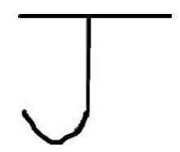
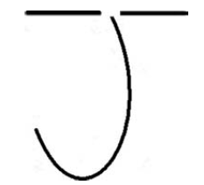
Generation of Graph
The letter J (Style 1).
Generated graph for the
letter J (Style 1).

Slide 48
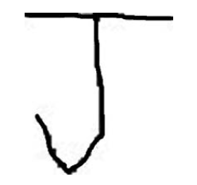
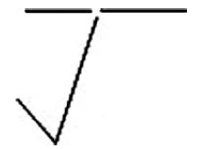
Generation of Graph
The letter J (Style 2).
Generated graph for
the letter J (Style 2).

Slide 49
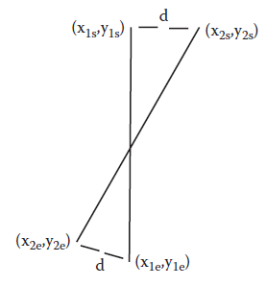
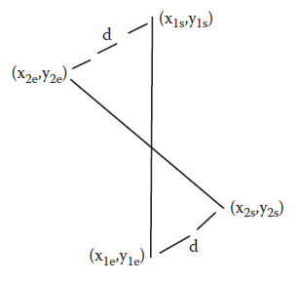
Generation of Graph
Calculating D1 with two lines.
Calculating D2 with two lines.

Slide 50
Generation of Graph
We even generalize the formula to the condition when either e1 or e2 is null.
The combined formula is given by Equations :
D1 (e1,e2) = square of distance of start points of e1 and e2 + square of distance of end points of e1 and e2, if e1 ≠ null, e2 ≠ null, e1 and e2 are both lines or curves with length > a
= square of distance of start points of e1 and e2 + square of distance of end points of e1 and e2 + b, if e1 ≠ null, e2 ≠ null, e1 is line and e2 is curve or e1 is curve and e2 is line
= square of distance of start points of e1 and e2 + square of distance of point of maximum separation of e1 and e2 , if e1 ≠ null, e2 ≠ null, e1 is curve and e2 is curve and length of e1 or e2 < a
= Distance between the starting point and end point of e1, if e2 is null
= Distance between the starting point and end point of e2, if e1 is null

Slide 51
Generation of Graph
D2(e1,e2) = square of distance of start point of e1 and end point of e2 + square of distanceof end point of e1 and start point of e2, if e1 ≠ null, e2 ≠ null, e1 and e2 are both lines or curves with length > a
= square of distance of start point of e1 and end point of e2 + square of distance of end point of e1 and start point of e2 + b, if e1 ≠ null, e2 ≠ null, e1 is line and e2 is curve or e1 is curve and e2 is line
= square of distance of start point of e1 and point of maximum separation of e2 + square of distance of point of maximum separation of e1 and start point of e2, if e1 ≠ null, e2 ≠ null, e1 is curve and e2 is curve and length of e1 or e2 < a.
= Distance between the starting point and end point of e1, if e2 is null
= Distance between the starting point and end point of e2, if e1 is null
D = min {D1 (e1, e2), D2 (e1, e2)}

Slide 52
Generation of Graph
Suppose that the edge e1 in the first graph has start points as (x1s, y1s) and end points as (x1e, y1e).
Similarly suppose that the edge e2 in the second graph has start points as (x2s, y2s) and end points as (x2e, y2e).
The point of maximum distance of e1 is (x1m, y1m) and e2 is (x2m, y2m). The formula just explained can also be stated as given by

Slide 53
Generation of Graph
D1(e1,e2) = (x1s–x2s)2 + (y1s–y2s)2 + (x1e–x2e)2 + (y1e–y2e)2, if e1 ≠ null, e2 ≠ null, e1 and e2 are both lines or curves with length > a
= (x1s–x2s)2 + (y1s–y2s)2 + (x1e–x2e)2 + (y1e–y2e)2, + b if e1 ≠ null, e2 ≠ null, e1 is line and e2 is curve or e1 is curve and e2 is line
= (x1s–x2s)2 + (y1s–y2s)2 + (x1m–x2m)2 + (y1m–y2m)2, if e1 ≠ null, e2 ≠ null, e1 is curve and e2 is curve and length of e1 or e2 < a
= (x1s–x1e)2 + (y1s–y1e)2, if e2 is null
= (x2s–x2e)2 + (y2s–y2e)2, if e1 is null

Slide 54
Generation of Graph
D2(e1,e2) = (x1s–x2e)2 + (y1s–y2e)2 + (x1e–x2s)2 + (y1e–y2s)2, if e1 ≠ null, e2 ≠ null, e1 and e2 are both lines or curves with length > a
= (x1s–x2e)2 + (y1s–y2e)2 + (x1e–x2s)2 + (y1e–y2s)2 + b, if e1 ≠ null, e2 ≠ null, e1 is line and e2 is curve or e1 is curve and e2 is line
= (x1s–x2m)2 + (y1s–y2m)2 + (x1m–x2s)2 + (y1m–y2s)2 if e1 ≠ null, e2 ≠ null, e1 is curve and e2 is curve and length of e1 or e2 < a
= (x1s–x1e)2 + (y1s–y1e)2 , if e2 is null
= (x2s–x2e)2 + (y2s–y2e)2 if e1 is null
D = min{D1(e1,e2), D2(e1,e2)}

Slide 55
Generation of Graph
Deviation of a Graph
The deviation of the graph uses the derived formula of the deviation of edges to find out the total deviation between any pair of edges.
Deviation(G1,G2)
Step 1: dev ← 0
Step 2: While first graph has no edges or second graph has no edges
Do
Step 3: Find the edges e1 from first graph and e2 from second graph such that deviation between
e1 and e2 is the minimum for any pair of e1 and e2
Step 4: Add its deviation to dev
Step 5: Remove e1 from first graph and e2 from second graph
Step 6: For all edges e1 left in first graph
Do
Step 7: Add deviation of e1 and null to dev

Slide 56
Generation of Graph
Step 8: For all edges e2 left in second graph
Do
Step 9: Add deviation of null and e2 to dev
Step 10: Return dev
The goal here is to minimize the total deviation that is the objective of the GA. We select the pair of edges, one from each graph, such that their deviation is minimal. We keep selecting such pairs until one graph gets empty.

Slide 57
Generation of Graph
Crossover
In crossover, we try to mix the existing graphs or solutions in order to generate hybrid solutions or graphs. These graphs form the next level of generation from the previous generation.
In this manner, we keep moving from one generation to the other in search for the optimal match. In this algorithm we try to create graphs that take some edges and vertices from the first parent and some from the other.
The aim is to generate a graph that may better match the input.

Slide 58
Generation of Graph
CrossOver(G1,G2)
Step 1: match ← MatchPoints(G1,G2) (Find points in G1 corresponding to G2 and vice versa)
Step 2: W1 ← GenerateAdjacency(G1) (Generates the Adjacency Matrix of the Graph)
Step 3: W2 ← GenerateAdjacency(G2)
Step 4: if W1 ≠ W2
Step 5: FindPaths(W1) (Finds the paths of all lengths between any pair of points)
Step 6: FindPaths(W2)
Step 7: p1 ← path between vertices v1 and v2 in G1 of length l, for all v1, v2 in W1 and
length l = 1, 2, 3, or 4 set

Slide 59
Generation of Graph
Step 8: p2 ← path between vertices match[v1] and match[v2] of length l2 in G2 of length
l2 = 1, 2, 3, or 4
Step 9: If p1 exists and p2 exists and p1 ≠ p2
Step 10: Remove all edges from W1 that are found in p1
Step 11: Add all edges in W1 that are found in p2
Step 12: g ← MakeGraph(W1,W2) (Generate graph out of Adjacency matrix of W1)
Step 13: Add g to solution set
Step 14 else g ← MakeGraph(W1,W2)
Step 15: Add g to solution

Slide 60
Generation of Graph
Matching of Points
This is the algorithm that we use to match or get the corresponding points between the two graphs.
If a point in graph 1 is said to match a point in graph 2, it may be assumed that a reference to the point in graph 1 would be taken as analogous to the reference to the matching point in graph 2.
In other words, suppose both graph 1 and graph 2 are the character I written in two different styles.
MatchPoints(G1,G2)
Step 1: ver1 ← all unique points in first graph which are at least a units distance apart from each other
Step 2: ver2 ← all unique points in second graph which are at least a units distance apart from each other
Step 3: match ← null

Slide 61
Generation of Graph
Step 3: While ver1 is not null or ver2 is not null
Do
Step 4: match[s2] ← s1 such that s1 is a vertex in ver1 and s2 is a vertex in ver2 and the distance between s1 and s2 is least for any combination of vertices in ver1 and ver2 and distance between s1 and s2 is less than a units
Step 5: Remove s1 from ver1
Step 6: Remove s2 from ver2
Step 7: For all vertex v in ver1
Do
Step 8: match[v] ← null
Step 9: For all vertex v in ver2
Do
Step 10: match[v] ← null

Slide 62
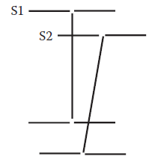
Generation of Graph
Matching points in
two graphs.
Generate Adjacency Matrix
Once the points have been identified and matched, the next step is to generate the graph. We use the adjacency matrix way of graph representation for this problem.
The path from a node x to a node y would also imply the path from the node y to the node x.
This means the final adjacency matrix (W) would be symmetric

Slide 63
Generation of Graph
Wij in the adjacency matrix for any pair of vertices i and j as given by :
Wij = 0 (If the node i is not directly connected by the node j) (15.7)
Wij = 1 (If the node i is directly connected by the node j by only 1 line)
Wij = 2 (If the node i is directly connected by the node j by only 1 curve)
Wij = 3 (If the node i is directly connected by the node j by only 1 line and 1 curve)

Slide 64
Generation of Graph
Algorithm to develop Adjacency Matrix
Generate Adjacency(G)
Step 1: W ← 0
Step 2: For all edges e in graph joining points i and j
Do
Step 3: Wij ← Wij + 1 (if e is a line)
Step 4: Wij ← Wij + 2 (if e is a curve)
Step 5: Wji ← Wij
Step 6: Return W

Slide 65
Generation of Graph
Find Paths
We know that we have a graph. This consists of a number of vertices. For this problem, we restrict ourselves to paths that are of length maximum 4.
existence of a path p, from a vertex i to a vertex j of a distance of exactly l. Here i and j can take any values and l is 1, 2, 3, or 4.
We also know that for single length (l = 1), a path is only possible if there is a direct edge between vertex i and vertex j. Hence the formula.
F(i,j,0) = i, if edge (i,j) exists or edge (j,i) exists
= null, otherwise

Slide 66
Generation of Graph
F(i,j,l) may be calculated as given in Equation
F(i,j,l) = k, if there is a path possible of length (l–1) between vertex I and vertex k and j is directly connected to j (l ≠ 0)
= null, otherwise.
This can also be written as given in Equation :
F(i,j,l) = k, if F(i,k,l–1) exists and (vertex (k,j) exists or vertex (j,k) exists), l ≠ 0
= null, otherwise.
Hence , we can find whether the path of length l exists between nodes i and j. If it exists, the value of F(i,j,l) is not null. If the path exists, we can find the path by reverse-iterating the data structure F.

Slide 67
Generation of Graph
Removing and Adding Edges
We apply the preceding data to find paths in the first and second graphs between any two points. If both paths are found, we remove the edges of the first path and add the edges of the second path from G1.
There may be various possibilities in the addition or removal. While removing an edge from vertex i to a vertex j in the graph, we take care of the following conditions :
If Wij = 0, or in other words there exists no edge from i to j, we break the operation.
If Wij = 1, or in other words there exists a line from i to j, we remove the line.
If Wij = 2, or in other words there exists a curve from i to j, we remove the curve.

Slide 68
Generation of Graph
If Wij = 3, or in other words there exists a curve and a line from i to j, we remove any one of them randomly chosen.
Wij > 3 is an illegal state and the operation is broken.
After the operation, Wij is made equal to Wji.
Here Wij refers to the adjacency matrix of graph 1 on which the removal operation is applied.
Generation of Graph
The last step is to convert the graphs in the form of an adjacency matrix into graphs in the form of an edges list. This graph contains the list of vertices along with their locations and details of the edges.
A pair here consisted of a point s1 in the first graph and s2 in the second graph.

Slide 69
Generation of Graph
The points from the graph were matched with those of the unknown input, and the deviation or the distance between these points was used in the fitness function. Moving the two ends of the lines or the curve might thus prove to be useful for optimization of the fitness value.
This optimization is called the distance optimization. We optimize the distance by moving the two ends of the line or curve in the new individual formed by crossover.
We optimize the distance by moving the two ends of the line or curve in the new individual formed by crossover.
We optimize the distance by moving the two ends of the line or curve in the new individual formed by crossover. This optimizes the distance as well, along with the style.

Slide 70
Generation of Graph
The algorithm for the formation of graph :
Step 1: for all vertices in W
Do
Step 2: for all vertices j in W that come after or at i
Do
Step 3: if Wij ≥ 2
Step 4: add a curve from x to y
Step 5: Wij ← Wij – 2
Step 6: if Wij = 1
Step 7: add a line from x to y

Slide 71
Results Of Handwriting Recognition
In order to check the working of the algorithm, we coded the algorithm. Java was used as a language.
Input was given in the form of images. Test data was also stored in the form of images.
In order to make the database, we first wrote each letter twice. The first time the letter was written perfectly, like the way we are taught. The second time we used a raw hand to introduce some imperfection.
The input data set was made by writing each character some enumerable number of times, using different ways.
The algorithm was made to first process the training data.
We used a total of 69 characters as the training data. The test data was a collection of 385 inputs.When the algorithm was made to run, it correctly identified 379 characters. It wrongly identified 6 test cases. This gave the efficiency of 98.44 percent.

Slide 72
Results Of Handwriting Recognition
Effect of Genetic Algorithms
Distance Optimization
The character that is input for identification may have the vertices of its graph at a point quite far from that of the training data.
Actually language allows us to end the various lines over a large distance. This depends on the writer and his writing style. But when we would compare the closeness of such an input, it is clear that the differences would be large.
On the other hand, identification by a human of the same character would be very easy.
Such a problem was highlighted when we tried to recognize the character M without the genetic algorithm.

Slide 73
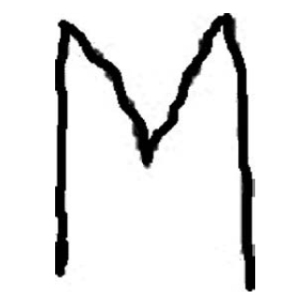
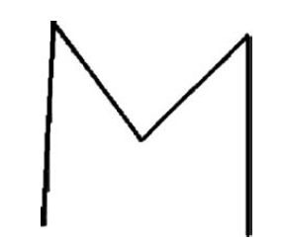
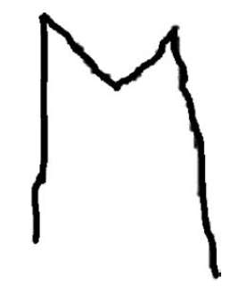
Results Of Handwriting Recognition
Input identified wrong
without genetic algorithm
Closest training data1 in the
wrongly identified input problem
Closest training data2 in the
wrongly identified input problem

Slide 74
Results Of Handwriting Recognition
Style Optimization
We have already discussed how the algorithm is very efficient in mixing two styles and generating a mixture of styles. This property of the algorithm to generate newer and newer styles proves very useful in the working of the algorithm.
In the training data set, we had given two distinct Bs in the training data of B. When operated without genetic algorithms, these two failed to match with the input of the data.

Slide 75
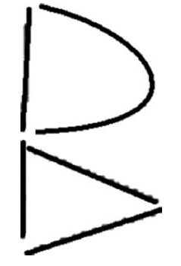
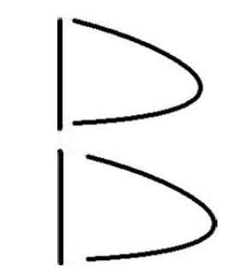
Results Of Handwriting Recognition
Input identified wrong without
genetic algorithm.
Graphical representation of
closest training data2 in the
wrongly identified input problem.

Slide 76
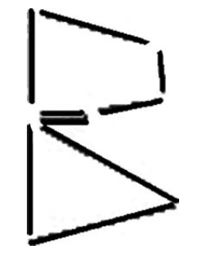
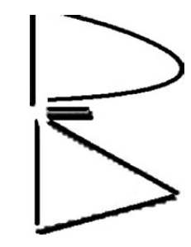
Results Of Handwriting Recognition
Graphical representation of closest
training data2 in the wrongly
identified input problem.
Genetic mixture of training data1
and training data2 in the wrongly
identified input problem.

Slide 77
Conclusion
In this chapter we first presented an approach to solve the problem of OCR. We devised a hierarchical model that first identified the language using a rule-based approach. Then the language-specific ANN was used to map the detection of the actual character that was identified. Using this method, we were able to easily identify the English capital letters, English small letters, and Hindi letters.
Introduced another concept that used GA for the purpose of handwriting recognition.
The GA helped in generating newer styles that better matched with the unknown input. Further the GA helped in optimizing or minimizing the deviation between the unknown input and the characters available in the training data set.

